Slide 1
Interview Simulator
Markiyan Varhola

Slide 2

Proposal
Interviews are stressful
Difficult to practice
Are usually important
Encountered often

Slide 3


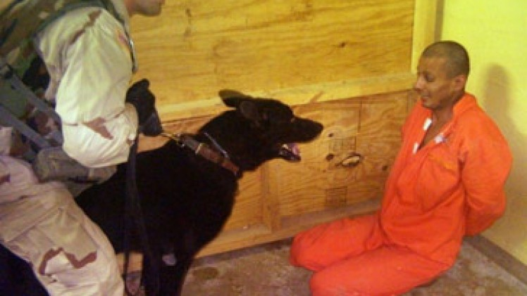

Scenarios
Job Interview
Date
Terrorist Interrogation
Public Address

Slide 4
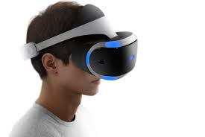
Requirements
VR Headset
Microphone

Slide 5
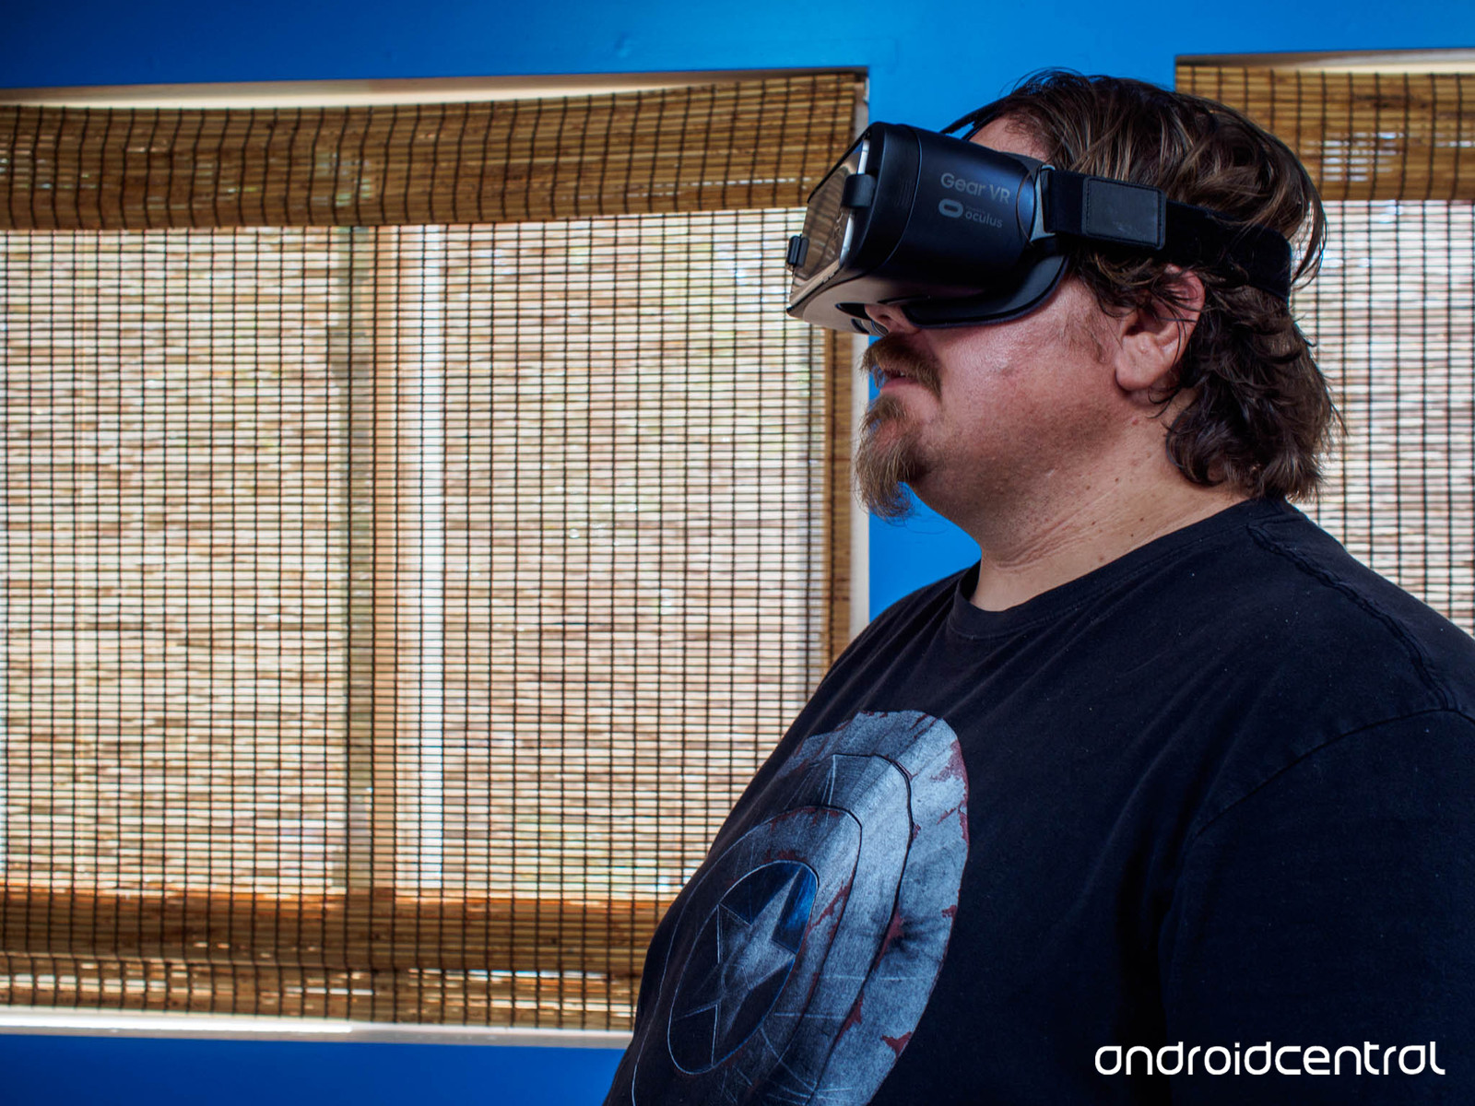
Purpose
Preparing for interviews without leaving your home!

Slide 6
Project
Virtual Reality Interview Simulation
Multiple scenarios
Selectable difficulty
Tutorials for successful interviews
Scoring system:
Check voice strength and fluctuations when speaking
Check eye contact
Multiple-choice tests

